Slide 1
CS 685 COMPUTER SECURITY PROJECT DEMO
PREPARED BY:
Akash Rajendra Ventekar
Himanshu Koyalkar
Poornimadevi Palanisamy

Slide 2
AGENDA
Implementation
AES in-built implementation
RSA in-built implementation
Custom AES implementation
Custom RSA implementation
Digital Hash Signature
Hash function
Chat application architecture and output
DNS implementation architecture and output
Performance evaluation

Slide 3
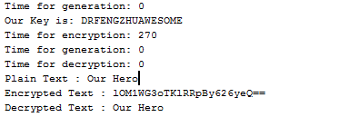
IMPLEMENTATION
AES Inbuilt Implementation
RSA Inbuilt Implementation

Slide 4
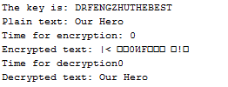
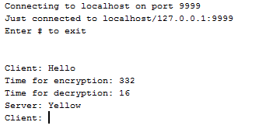
IMPLEMENTATION
Custom AES Implementation
Custom RSA Implementation

Slide 5
IMPLEMENTATION
Digital Signature

Slide 6
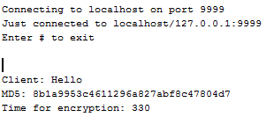
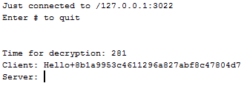
HASH FUNCTION:
At Client:
At Server:

Slide 7
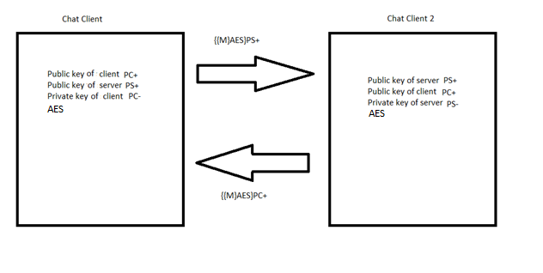
ARCHITECTURE
CHAT APPLICATION

Slide 8
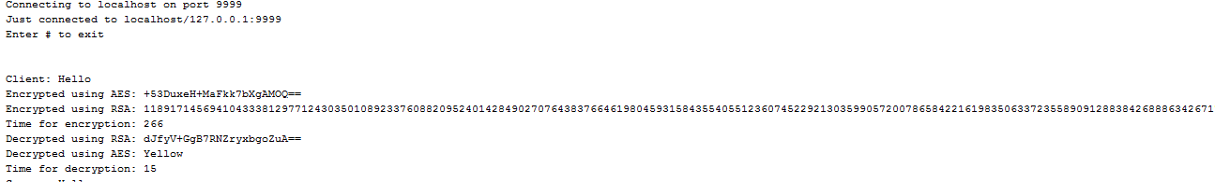
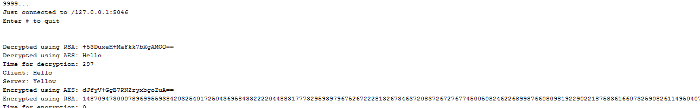
Chat Application
Client:
Server

Slide 9
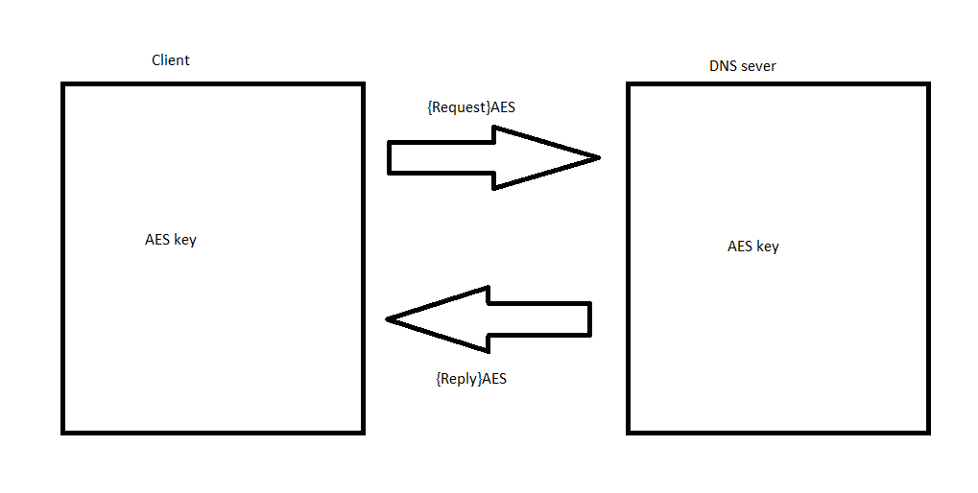
ARCHITECTURE
DNS APPLICATION

Slide 10
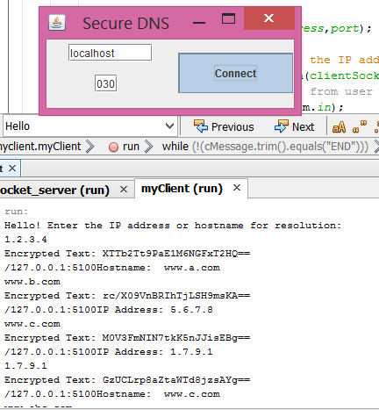
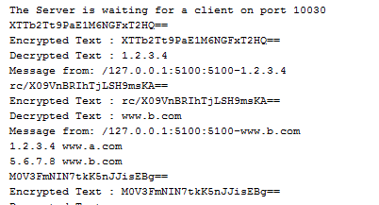
DNS SERVER WITH AES ENCRYPTION
Client Implementation:
Server Implementation

Slide 11
PERFORMANCE EVALUATION:
S.No | Generation (in ms) | Encryption (in ms) | Decryption (in ms)
Library implementation of RSA generation of public and private key | 1540 | 1500 | 17
AES custom implementation | 0 | 1 | 1
AES Library implementation | 0 | 300 | 1
RSA custom implementation | 1 | 1 | 20
Custom implementation for RSA & AES library encryption | 300 | 300 | 20
Digital signature | 1500 | 20 | 1
Hash | 1 | 1 | 1

Slide 12
Thank you

